Slide 1
Semester work example
Wooden toys e-shop

Slide 2
Steps
Product statement
Business Requirements
Use Cases Model
First domain model
Goals definition
List of UseCases
Detail UseCases (min. 5 main important UCS)
  Activity diagrams for UseCases
Final Domain model
Final Class Diagram
Sequence diagram for classes
State diagram for whole project

Slide 3
Product statement
Eshop with wooden toys "Pinokijo.cz" allows parents of preschool children comfortable and quick purchase of handmade wooden toy from our family manufactory.
An e-commerce platform allows users to search for products in various categories, add them to a shopping cart, and subsequently purchase the items in the cart. Each product has a rating, so users can see the number of stars and a text providing recommendations or complaints about individual products. Only registered users can rate products, and only registered users can also make purchases. Searching is available for registered users. When a user adds an item to the cart and proceeds to checkout, they must register at that point if they haven't done so yet. The system remembers already registered users and automatically logs them in if cookies are enabled. The system displays new arrivals in a prominent area and offers potential discounts. It also shows advertisements for various products available in the system. The system is managed by an administrator who maintains it, while registered users can make purchases. Non-registered users can search for products, read product reviews, or view new arrivals.

Slide 4
Product statement general concept
Long-term goal:
Purpose:
Target audience:
Value and uniqueness:
Inspiration and motivation:

Slide 5
Business (system) requirements
Functional
  Simple e-shop
  Goods sent by cash on delivery
  The more people buy then it is better
  At present, our clients prefer in person recommendation
Non-functional requirements
  Response time smaller than >10 seconds,
  Availability 7 days per week 24 hour per 98% per year,
  login authorization/authentication provides Google inc.
Defines the boundaries of the problem

Slide 6
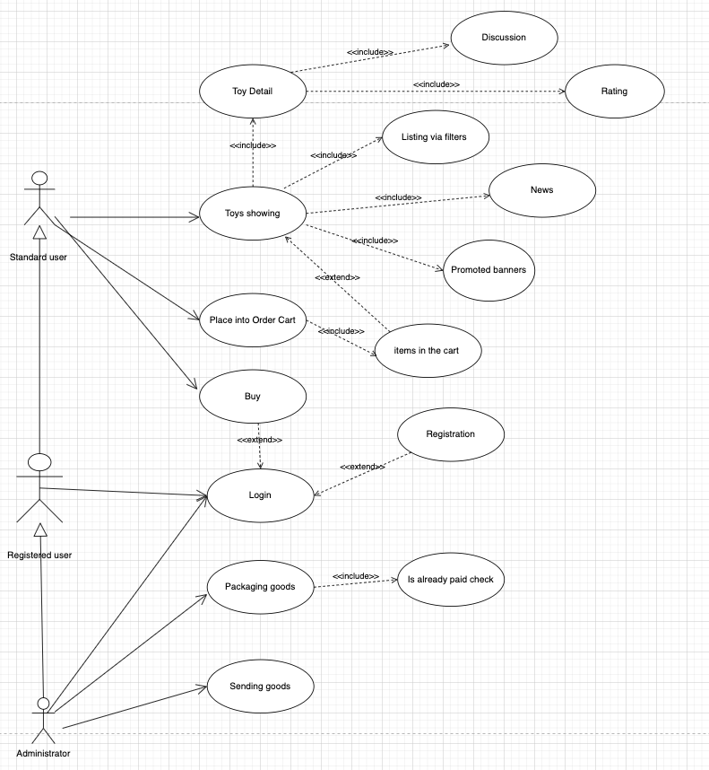
Use Case High Level Model Generate from Statement

Slide 7
Goals definition
Now we need to define the goals that should be achieved in our e-shop. From these, we will then create detailed Use Cases.

Slide 8
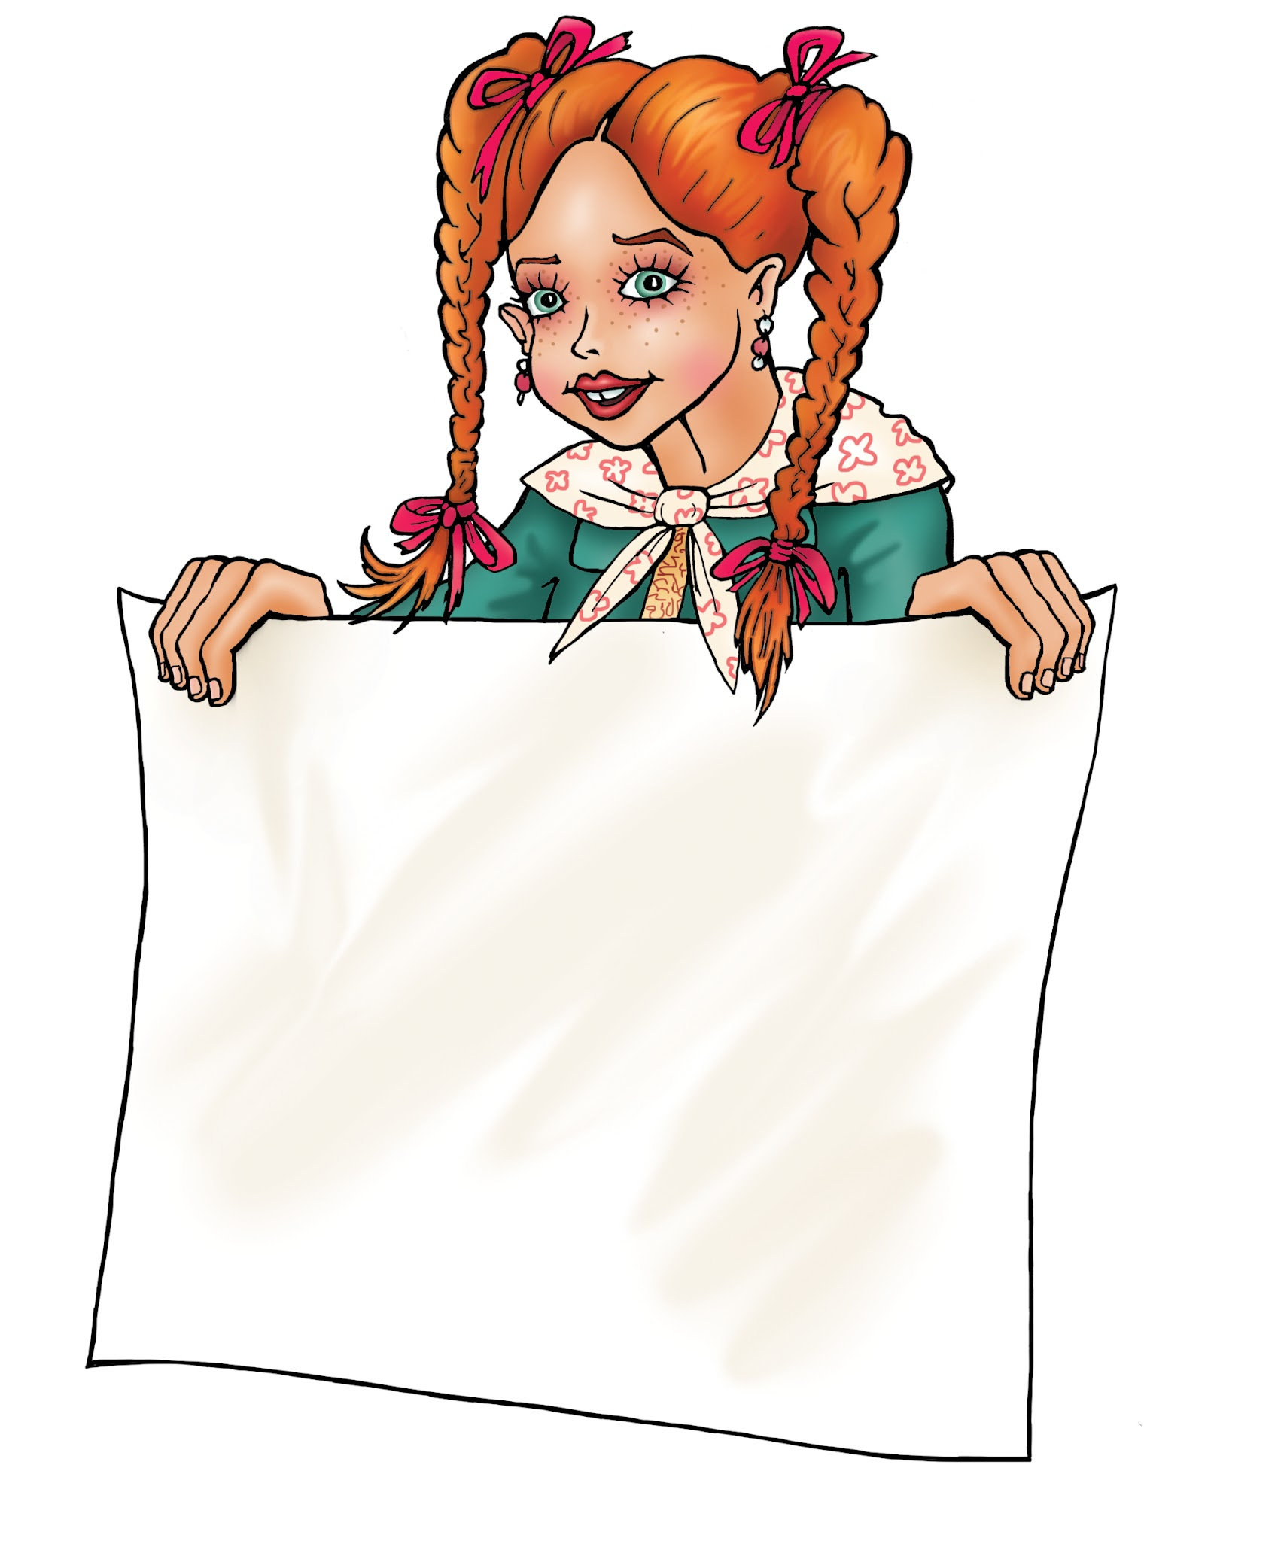
Wooden toys e-shop User Goals
On the is landing page a selection of toys, news and banners
View toys in categories
Detail and more photos for each toy
Add toy into cart
In the cart
  Delete an item
  Number of items
User login
Payment and shipping selection
Data check and order confirmation

Slide 9
Wooden toys e-shop User Goals
Product discussion
Product evaluation
Possibility to sort products in the category (price, name)
In the detail of the toy, also list the recommendations for other toys from category
View standard (required) information:
  About us
  Business conditions
  Contacts
Attention:
From the Goals we are deriving Use Cases!

Slide 10
List of UseCases and Scenarios on Home Page
Toys selection by the categories (User Goal 1,2)
Toys sorting by categories (User Goal 11)
News(User Goal 1)
Advertising banners(User Goal 1)
Number of items in the cart(User Goal 5b)
Remove (clear) items from the cart(User Goal 5a)
  From main page
  From detail basket
View standard (required) information(User Goal 13a,b,c)
That are NAMES OF USECASES ONLY, NOT UseCases description. UseCases are very often numbered for easy orientation or join with User Goal.

Slide 11
List of UseCases and Scenarios on Product and List page
Possibility to sort products in the category by price or name(User Goal 11)
Detail description and photos, discussion, rating for each toy(User Goal 3)
Add toy into the cart(User Goal 4)
Toy evaluation (rating) of other customers (User Goal 10)
  to rate the product in the five-point scale during the finish of ordering
List of recommendations from other customers(User Goal 12)

Slide 12
Cart page UseCases and Scenarios
List of items in the cart(User Goal 5b)
Remove selected item/s from the basket(User Goal 5a)
Return back to the Home Page
Go to the cash register and define payment method(User Goal 7)
  Select shipping method(User Goal 8)

Slide 13
User section UseCases and Scenarios
Puting or checking information about the user if the user wants to be registered
Login into the User section

Slide 14
Toys selection by the categories (User Goal 1,2)
UseCase
On the Home Page the user expects:
Wooden figures,
Wooden animals,
Wooden cars,
Wooden cubes, puzzles, playing fields
Others (you must be exact, others means different toys which are not joining for defined categories)
After the Toy selection (NOT after button click) he/she expect to be moved to the detail info about the product.
Scenario
The system shows vertical menu with defined (by UseCase) categories:
Allows category selection
  If user focused on the item, the item is highlighted
  If user click, the system shows sub menu with each items
  If user select item, the system follow the UC = Detail page

Slide 15
Toys sorting by categories (User Goal 11)
UseCase
On the Home Page the user expects sorting page according to categories:
Name,
Price,
After the category selection, user expects the result page will be ordered.
Scenario
The system shows Combo Box with defined categories:
Allows the category selection:
  The system shows the filtered list of items according to the chosen category.
  The system allows switching between categories.
  Ater category selection ty system automatically refreshes the screen

Slide 16
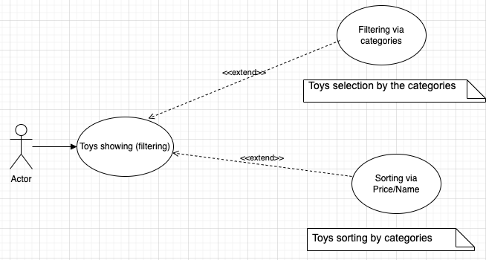
Diagram for UseCases toys selection and sorting
I'm using Extend because I suppose it will be called from another UseCases (cart for example)

Slide 17
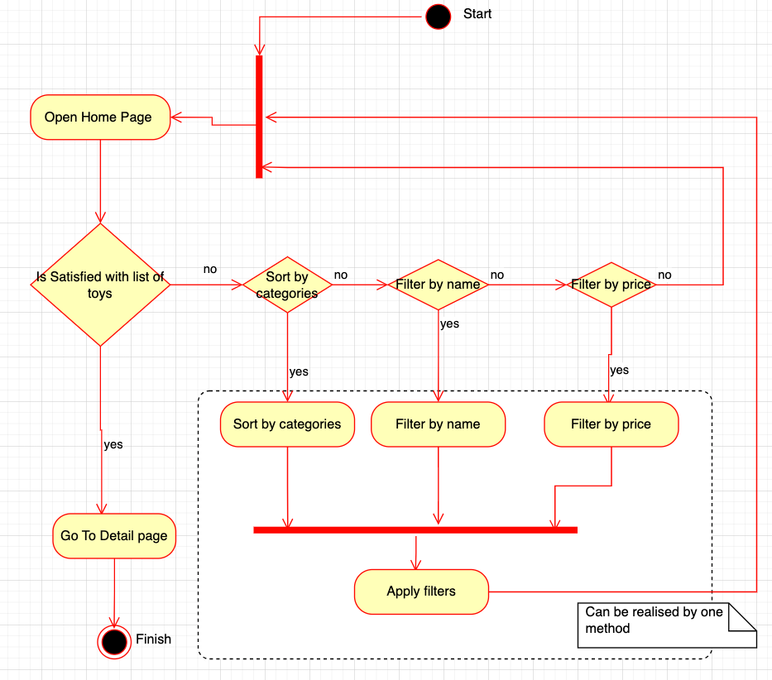
Activity (scenario) diagram for toys selection and sorting

Slide 18
News(User Goal 1)
UseCase
On the Home Page the user expects news notices arranged clearly and always visible:
News icon
News notice
After the notice selection the user expects to be moved to news detail
Scenario
The system shows news panel with:
News image
New description:
  Description is highlighted
  If the user clicks on the highlighted description, the system shows the News detail page (not implemented thanks thats the school example only…)

Slide 19
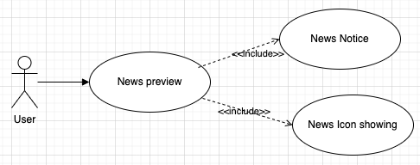
News UseCase diagram

Slide 20
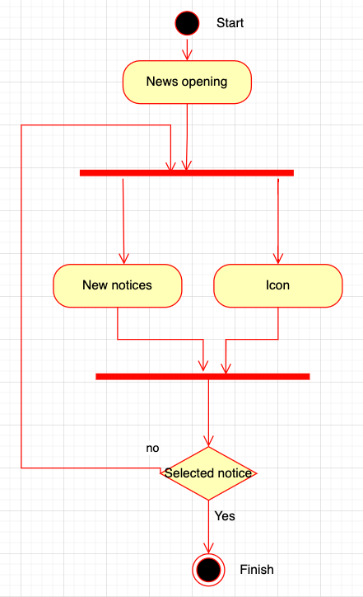
Activity (scenario) diagram for News

Slide 21
Advertising banners(User Goal 1)
UseCase
On the Home Page the user expects advertising (promo) banners located at the main focus area:
The user expect two types of banners:
  Main banner (big one)
  Supplementary banners (smaller and located on the less focus area)
After the banner selection the user expects to be moved to promotion detail
Scenario
The system shows promo banners at the center of the screen.
2 main banners ordered horizontally
4 supplementary banners located under the main banners
  If exist more banners, the banners are moved horizontally like carousel
  If the user clicks on the promo, the system shows the Promo detail page (not implemented thanks thats the school example only…)

Slide 22
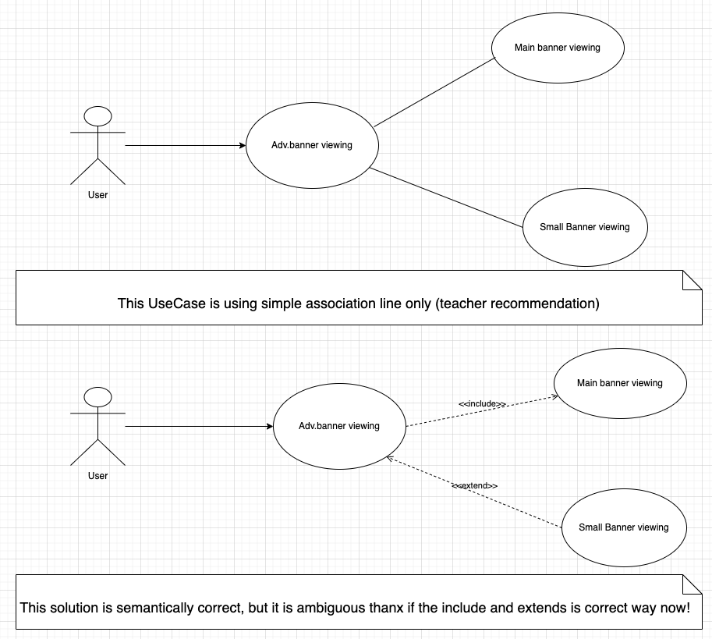
Advertising banner UseCase model

Slide 23
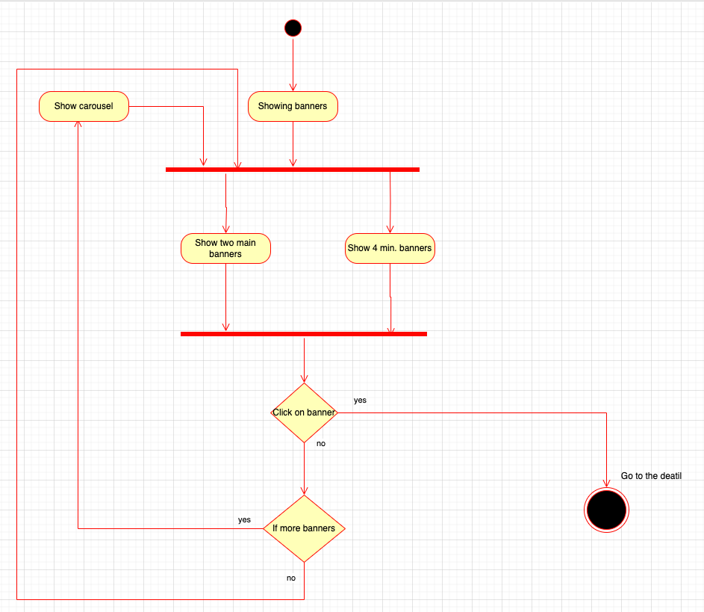
Advertising banner Activity diagram

Slide 24
Add toy into cart(User Goal 4)
UseCase
On the Detail page the user expects to have possibility to add the toy into the cart.
After adding into the cart the user expects to have information about the number pieces in the cart.
Scenario
The systems shows:
Cart icon and add button below the icon
After pressing the button the system shows label with the number of pieces located in the cart.

Slide 25
Number of items in the cart(User Goal 5b)
UseCase
On the Home Page the user expects to have information about items in cart
Number of items
Prices
After the cart selection the user expect to be moved into the cart detail.
Scenario
The system shows cart Icon. Below the icon shows the number of ordered items and total sum.
  SUM is highlighted
  If the user clicks on the highlighted sum (or cart icon), the system shows the Cart detail page

Slide 26
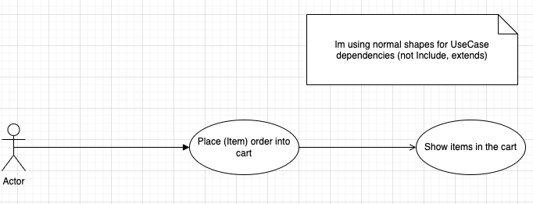
Add item in the cart and Number of Items in the cart UC diagram

Slide 27
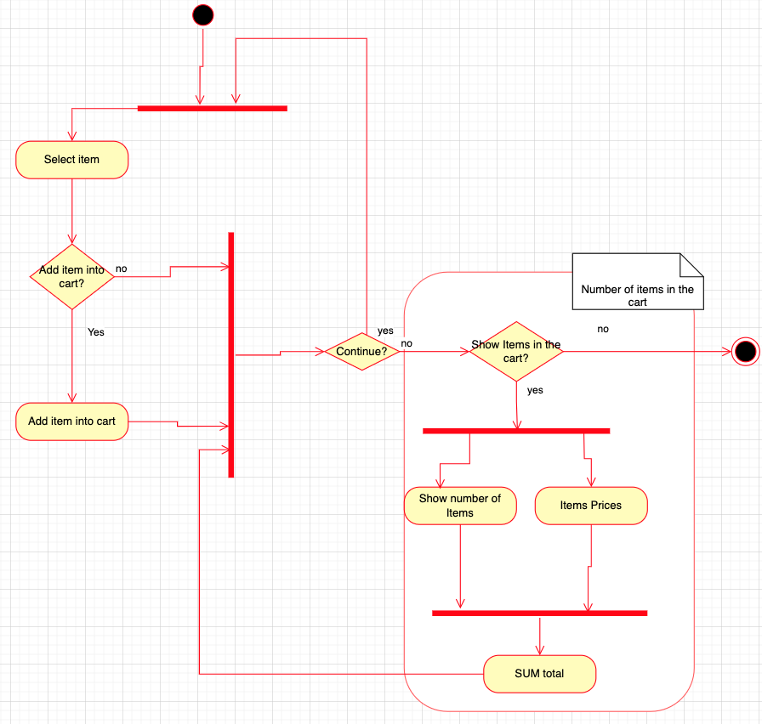
Add item into cart and number of Items in the Scenario

Slide 28
Remove (clear) items from the cart(User Goal 5a)
UseCase
On the Home Page Or Detail cart page the user expects clear items from the cart:
By selection the item should be removed
Scenario
The system allows the user jump into the Cart detail page(UseCase - List of items in the cart)by click on the Cart icon.
Each item has remove button.
If the user press the remove, the system asks, if the user really wants to remove the item:
  If yes, the system removes the item
  If not, the system does nothing.

Slide 29
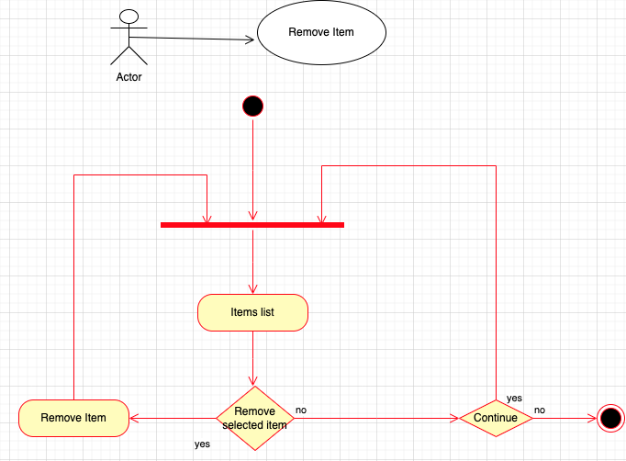
Remove Item UC Diagram and Scenario Diagram

Slide 30
Detail description and photos, discussion, rating for each toy(User Goal 3)
UseCase
On the Detail page the user expects:
preview image,
list of others images,
price of the toy,
number of pieces in the stock
customers rating in the five-point scale
product description
product discussion with the customer Nickname and text and rating
possibility to add new discussion and rating
Scenario
The systems shows:
preview image as icon (width 45%, height 25%)
under the image list button for:
  Previews
  Next
label for price value of the item
customer ratings as asterisks below the item price in in the five-point scale
label for pieces number in the stock
flow text with the product description
New tab for Discussion section with the:
  Label and Text Field for putting Nickname
  TextArea for the description
  five-point scale for rating
  Button for adding the discussion and rating

Slide 31
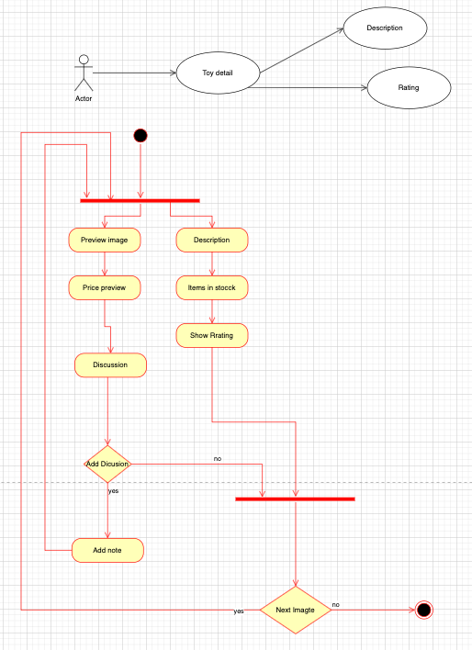
Detail description and photos, discussion, rating for each toy UC and Scenario

Slide 32
View standard (required) information(User Goal 13a,b,c)
UseCase About Us:
The user expects to read:
IČ, DIČ, information on the operation of the e.shop on the market, reason for the business, motto.
UseCase Terms and Conditions:
Definition of business conditions, rules of sending goods, return of goods, rules of complaint, information about warranty.
Scenarios About US,Terms and Conditions, Contacts
The system shows labels for defined attributes in the pages About US,Terms and Conditions, Contacts.
UseCase Contacts:
Contact information line (email, phone), complaint line, company address, name and surname of the contact person, ID number, VAT number.

Slide 33
Possibility to sort products in the category(User Goal 11)
UseCase
On the List or Detail page the user expects sort the results by:
Name
Price
The user expect listing values if exists more than 25 values
Scenario
The systems shows list box with defined attributes (in UseCase).
If the user selects particular attribute, the system sorts the main screen according the attribute.
  If there exist more values then 25, the system shows the next list button

Slide 34
List of items in the cart(User Goal 5b)
UseCase
On the Cart page the user expects:
name, number of pieces, price per one product,
change the number of items in the cart,
total sum,
remove selected item/s from the cart,
methods for continuing shopping,
possibility to finish order.
Scenario
The systems shows:
Table with defined attributes
  Drop down menu for changing number of pieces
  Remove button for deleting item(s) located in the cart
  Button for the next shopping operation:
    On Click, the system shows the List page with the last defined sorting filter.
  Button for finishing the order:
    On Click the system goes to Use Case(Go to the cash register)

Slide 35
Go to the cash register and define payment method(User Goal 7)
UseCase Select payment method:
On the Cart page the user expects options:
pay by card,
online,
payment on delivery
UseCase Select shipping method(User Goal 8)
Send to my address by name, surname, street and number, town, ZIP code, phone, email, date of delivery
Method for the order finishing
Scenario Select payment method by:
The systems shows:
ComboBox for the pay variants
  After selection the system show another step-> select shipping UC
Scenario Select shipping method:
Labels and TextFields for defined attributes
Finish button:
  On click - the system finishes the order

Slide 36
Puting or checking information about the user
UseCase registration/update values:
On the User page the user expects to add:
Personal: name, surname, birth date (month, year),
Address: Street name and number, Town, ZIP Code
Personal info: email, mobile
Set or update password by putting password and check it once again
Scenario registration/update values:
The systems shows:
Labels and TextFields for defined attributes Personal, Address, Personal Info,
The Save button:
  On click the system updates defined attributes

Slide 37
Login into the User section:
UseCase
On the User page the user expects login into the section by:
By username (email or phone number) and password
After the finish the user expects to entrance into the User Section
Scenario registration/update values:
The systems shows:
Label and TextField for username
Label and Password field for password
Button login:
  On Click the system follows into the UserSection page
    If exception the system generates error message ….next UserCases are not implemented thanks that's the school example only...

Slide 38
User section UseCases
On the User section page the user expects:
Puting or checking information about him/her self if he/she needs to be registered:
  Name, surname, birth date (month, year),
  Address: Street name and number, Town, ZIP Code
  Personal info: email, mobile
  Set or update password by putting password and check it once again
Login into the User section:
  By username (email or phone number) and password

Slide 39
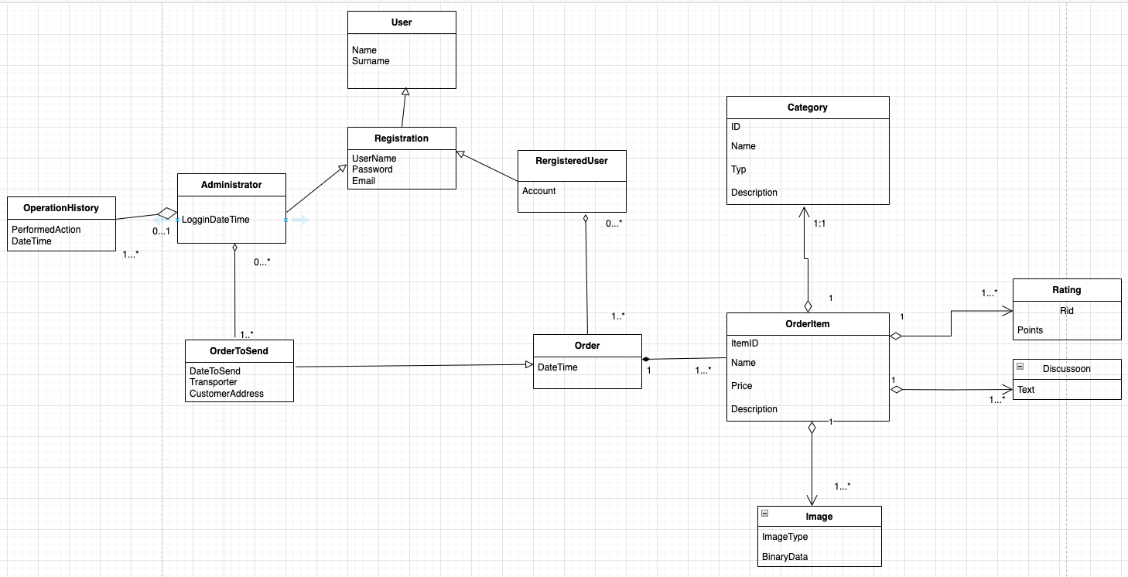
Domain model

Slide 40
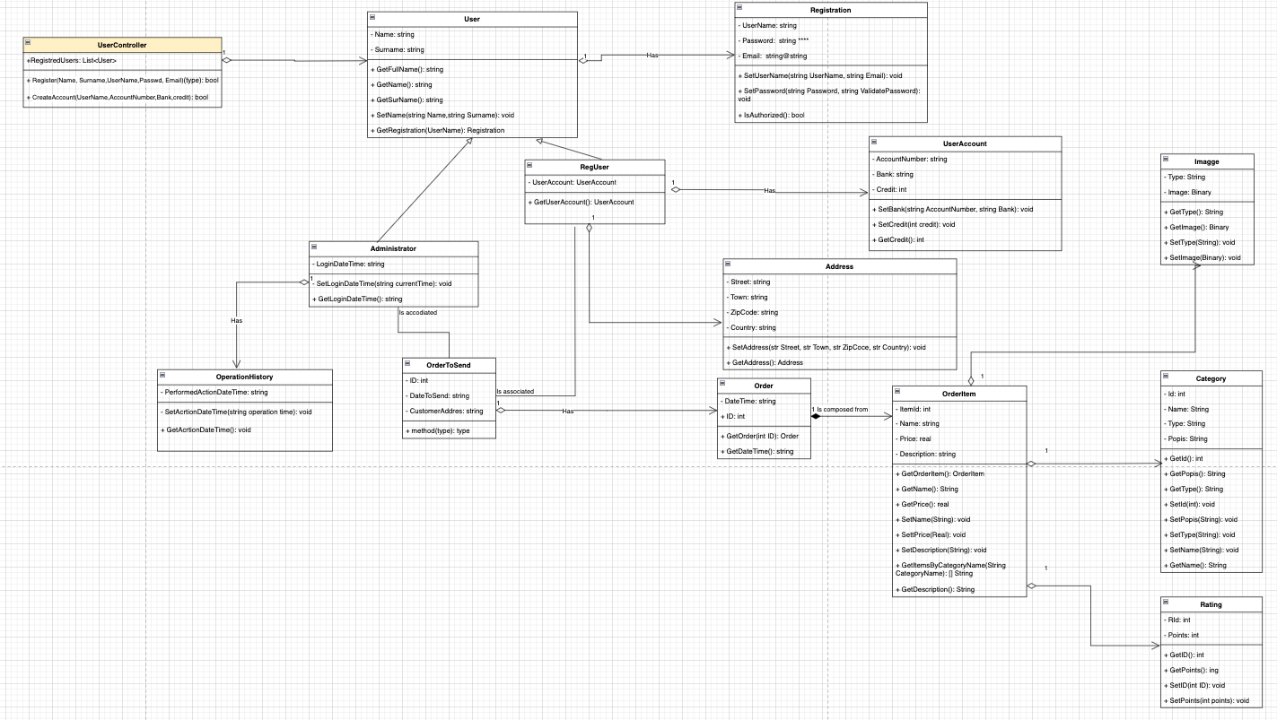
Class diagram

Slide 41
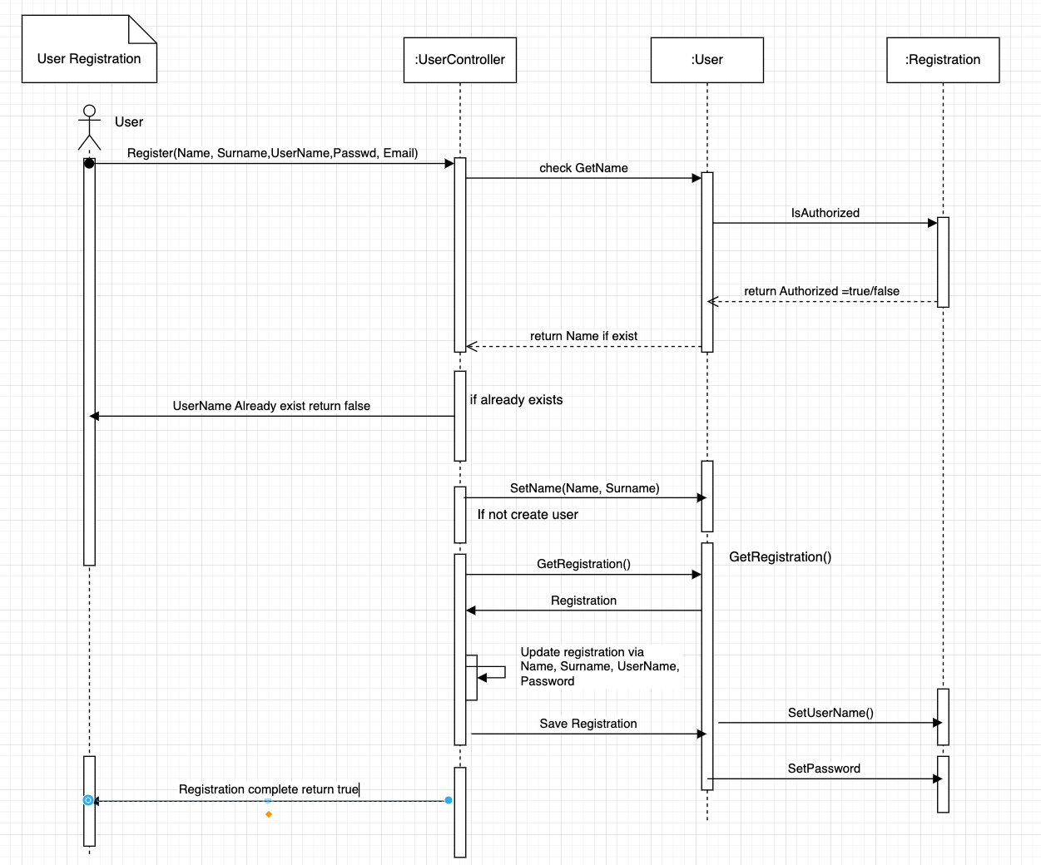
User Registration sequence diagram

Slide 42
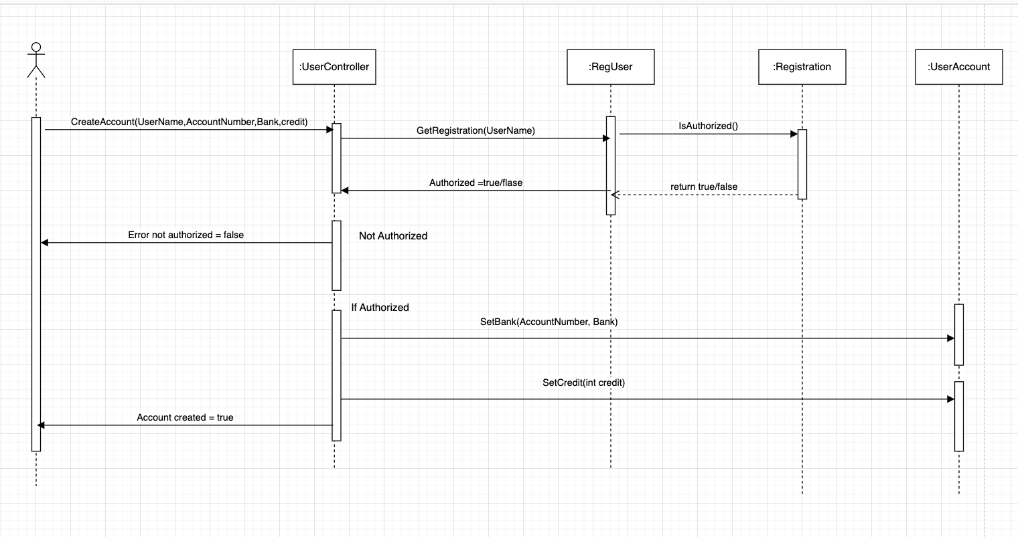
Register user bank account sequence diagram

Slide 43
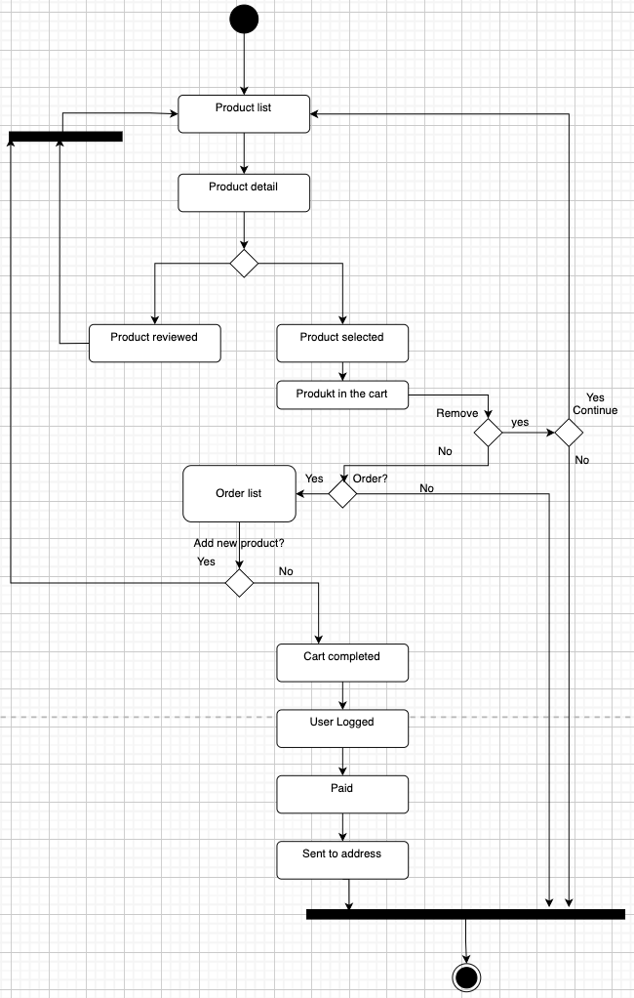
Wooden Toys E-shop
state diagram

